Slide 1
ML Webinar 3 : Understanding Proximity Measures and K-Nearest Neighbors

Slide 2
Agenda
Proximity Measures
Implementing Proximity Measures in Python
K-Nearest Neighbors (KNN) Algorithm
Implementing KNN in Python
Applying KNN on Real-world Data
Parameter Tuning and Model Evaluation

Slide 3
Proximity Measures
Definition: Proximity measures quantify the similarity or dissimilarity between data points in a dataset.
Importance:
Crucial for various machine learning algorithms, such as KNN, clustering, and recommendation systems.
Enable algorithms to make decisions based on the proximity of data points.
Aid in data preprocessing tasks like outlier detection and feature selection.
Provide insights into the structure and relationships within the data.
Facilitate tasks such as classification, regression, and pattern recognition by identifying similar instances.

Slide 4
Why Proximity Measures Matter
Recommender systems utilize similarity measures for personalized recommendations.
KNN algorithm relies on proximity for classification and regression.
Clustering algorithms group data points based on proximity.
Proximity measures are vital for anomaly detection and dimensionality reduction.
They enhance information retrieval and natural language processing tasks.

Slide 5
Common Types of Proximity Measures
Euclidean Distance: Measures the straight-line distance between two points in Euclidean space.
Manhattan Distance: Measures the distance between two points along the axes at right angles.
Cosine Similarity: Measures the cosine of the angle between two vectors.
Jaccard Similarity: Measures the similarity between sets by comparing their intersection and union.
Minkowski Distance: It is a generalization of both Euclidean distance and Manhattan distance. It is a metric used to measure the distance between two points in a normed vector space.
Gower distance: To calculate the dissimilarity between two data objects in a dataset that contains a mixture of different types of variables, such as numerical, categorical, and ordinal variables.

Slide 6
Applications of Proximity Measures
Practical applications of proximity measures:
Image recognition: Cosine similarity for comparing image features.
Document clustering: Euclidean distance for grouping similar documents.
Customer segmentation: Manhattan distance for clustering customers based on purchasing behavior.
Anomaly detection: Use proximity measures to identify outliers in sensor data, indicating potential faults or anomalies in machinery.
Network security: Utilize Jaccard similarity to detect similarities in network traffic patterns, helping to identify potential cyber threats and attacks.
Sensor fusion: Combine proximity measures from multiple sensors to improve accuracy in localization and navigation systems, such as in autonomous vehicles or indoor positioning systems.

Slide 7
Similarity and Dissimilarity Measures
In proximity measures, both similarity and dissimilarity measures are used in different contexts depending on the specific task or algorithm being employed:
Similarity Measures:
Similarity measures quantify how alike or related two objects or data points are. High similarity values indicate that the objects are more alike or closely related. These measures are commonly used in :
Recommender systems: To suggest items or content similar to what a user has previously interacted with or liked.
Clustering: To group together data points that are similar to each other, forming clusters or communities.
Information retrieval: To rank documents or search results based on their relevance or similarity to a query.
Image recognition: To compare features of images and identify similar images within a dataset.

Slide 8
Similarity and Dissimilarity Measures
Dissimilarity Measures:
Dissimilarity measures quantify how different or unrelated two objects or data points are. High dissimilarity values indicate that the objects are more different or unrelated. These measures are commonly used in:
Hierarchical clustering: To determine the distance between clusters or data points when forming a hierarchical cluster tree.
Anomaly detection: To identify outliers or anomalies in a dataset by measuring the deviation of a data point from the rest of the data.
Classification: In some classification algorithms, dissimilarity measures are used to assign class labels based on the distance or dissimilarity between data points and class prototypes.
In summary, while similarity measures focus on identifying relationships or similarities between objects, dissimilarity measures focus on quantifying differences or distances between objects.

Slide 9
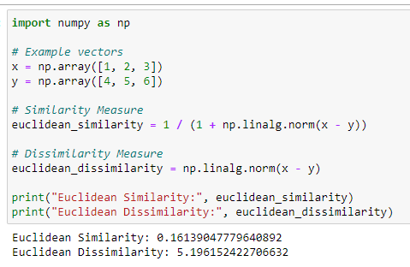
Calculating Proximity Measures in Python
Euclidean Distance: In NumPy, you can use the numpy.linalg.norm()
function to compute the Euclidean distance between two points.
Euclidean similarity between vectors by taking the reciprocal of the
Euclidean distance (L2 norm) between them. Dissimilarity calculates the
Euclidean distance (L2 norm) between the vectors

Slide 10
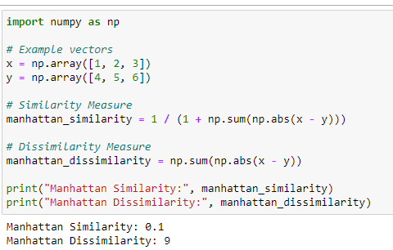
Calculating Proximity Measures in Python
Manhattan Distance: While there isn't a direct built-in function for Manhattan
distance in NumPy, you can compute it using NumPy's np.abs() and
np.sum() functions.

Slide 11
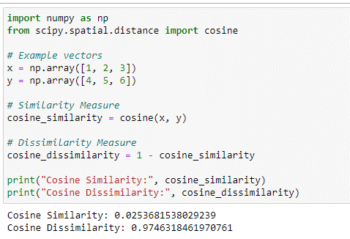
Calculating Proximity Measures in Python
Cosine Similarity: The cosine() function from scipy.spatial.distance to
compute the cosine similarity between two vectors.

Slide 12
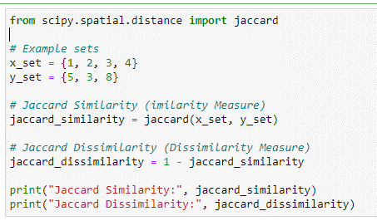
Calculating Proximity Measures in Python
Jaccard Similarity: The jaccard() function from
scipy.spatial.distance to compute the Jaccard similarity between two sets.

Slide 13
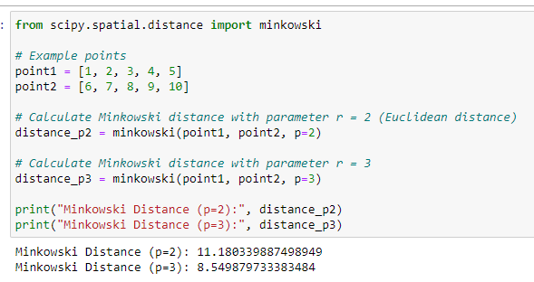
Calculating Proximity Measures in Python
Minkowski Distance: Minkowski distance is a flexible distance metric that
can be adjusted based on the value of the parameter r. Smaller values of r
emphasize differences in individual features, while larger values give more
weight to overall differences.

Slide 14
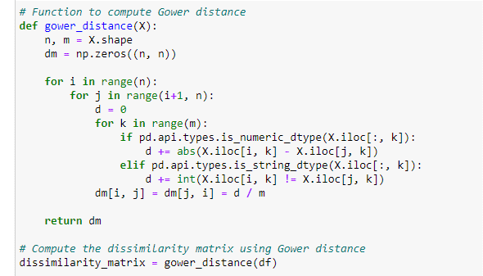
Calculating Proximity Measures in Python
The Gower distance takes into account the nature of each variable type
when computing the dissimilarity between two objects. For numerical
variables, it typically uses the normalized absolute difference, while for
categorical variables, it uses the so-called matching coefficient, which is
the proportion of attributes that match in the two objects being compared.

Slide 15
Demo - Proximity Measures
in Python

Slide 16
K-Nearest Neighbors (KNN)
K-Nearest Neighbors (KNN) is a simple yet powerful supervised learning algorithm used for classification and regression tasks.
It operates on the principle of proximity, where the class or value of an unseen data point is determined by the majority class or average value of its k nearest neighbors in the feature space.

Slide 17
K-Nearest Neighbors (KNN)
How KNN makes predictions:
Given a new data point, KNN calculates the distances between this point and all other points in the dataset.
It then identifies the k nearest neighbors based on these distances.
For classification tasks, KNN assigns the class label that is most common among the k neighbors.
For regression tasks, KNN predicts the average value of the target variable among the k neighbors.

Slide 18
Proximity Measures in KNN
Proximity measures, such as Euclidean distance and Manhattan distance, play a crucial role in KNN by quantifying the "closeness" or similarity between data points.
These measures enable KNN to identify the nearest neighbors for a given data point, which are then used to make predictions.
In KNN, the choice of proximity measure directly influences the outcome of the algorithm.
Different measures may yield different results and performance. It's essential to select an appropriate proximity measure based on the nature of the data and the task at hand.

Slide 19
Pros and Cons of KNN
Advantages of KNN:
Simplicity: KNN is easy to understand and implement.
Versatility: It can be applied to both classification and regression tasks and works well with non-linear data.
No assumptions: KNN does not make any assumptions about the underlying data distribution, making it suitable for various types of data.
Limitations of KNN:
Computational inefficiency: inefficient for large datasets.
Sensitivity to irrelevant features: KNN considers all features equally important, making it sensitive to irrelevant or noisy features.
Need for appropriate distance metric: The choice of distance metric (e.g., Euclidean, Manhattan) significantly impacts KNN's performance and may require careful selection and tuning.

Slide 20
K-Means Clustering
Dataset: https://www.kaggle.com/c/house-prices-advanced-regression-techniques/data
"Housing Prices" dataset from Kaggle, which contains information about the sale of houses in a city in the USA.
Importing Libraries - First, we will import the necessary libraries for data manipulation, visualization, and clustering.
pandas as pd
numpy as np
matplotlib.pyplot as plt
seaborn as sns
from sklearn.cluster - KMeans
from sklearn.preprocessing - StandardScaler

Slide 21
K-Means Clustering
Load Dataset
Explore dataset
Select features ['OverallQual', 'GrLivArea', 'YearBuilt’]
Scale features
Kmeans clustering using sklearn.cluster.
Each function:
n_clusters: Specifies the number of clusters to create.
init: Specifies the method for initializing the initial cluster centroids. The types used are: 'k-means++’ and 'random’.
random_state: Seeds the random number generator for reproducibility. It ensures that the algorithm produces the same results when given the same data and parameter settings. This is important for reproducibility in your analysis.

Slide 22
K-Means Clustering
Choosing the Number of Clusters: One way to do this is to use the elbow method, which plots the within-cluster sum of squares (WCSS) as a function of the number of clusters.
We want to choose a number of clusters that minimizes the WCSS while still capturing the inherent structure of the data.
Performing K-Means Clustering.
Visualize the clusters by creating a Scatterplot.

Slide 23
Intrusion Detection
The data sets contain the records of the internet traffic observed by a simple intrusion detection systems in the computer network monitoring the network traffic and identify the ghost attacks in the network. The data set contains 43 features per record, with 41 of the features referring to the traffic input itself and the last two are labels (whether it is a normal or any of the network attack type) and Level (the severity of the traffic input itself).
Dataset: https://www.kaggle.com/datasets/hassan06/nslkdd
Importing Libraries - First, we will import the necessary libraries for data manipulation, visualization, and clustering.
pandas as pd
numpy as np

Slide 24
Intrusion Detection
import seaborn as sns
matplotlib.pyplot as plt
from sklearn.model_selection import train_test_split
from sklearn.preprocessing import StandardScaler
from sklearn.metrics import confusion_matrix
from sklearn.metrics import precision_score, recall_score, f1_score
from scipy.stats import multivariate_normal
from sklearn.neighbors import LocalOutlierFactor
from scipy.spatial.distance import cdist
from sklearn.cluster import KMeans

Slide 25
Intrusion Detection
Load Dataset
Explore dataset
Data Preprocessing
Separate the features and the target variable
Split the dataset into training and testing sets
Scale features
Define evaluation metrics
K-means algorithm

